Slide 1
Big Data Understanding
Big data is different . The traditional data processing tool could not be helpful to analyze the big data. The organization and features are different of big data than distributed databases. The different is strong and specific.
Distributed database mainly focuses the features of reliability, availability, and accessing of data from the local system through high level of transparency. The Big data must be capable of handling high speed and variety of days with quick accessing and analyzing.
Dr. Supriya Chakraborty

Slide 2
Big Data?
Extremely large data sets that may be analyzed computationally to reveal patterns, trends, and associations, especially relating to human behavior and interactions.
In the early 2000s, industry analyst Doug Laney articulated the mainstream definition of Big data with 3V’s.

Slide 3
What is Big Data?
Big data is a combination of unstructured, semi-structured or structured data collected by organizations. This data can be mined to gain insights and used in machine learning projects, predictive modeling and other advanced analytics applications.
Big Data is characterized by 5 V’s, today.
Organizations that use big data have a potential competitive advantage over those that don't since they can make faster and more informed business decisions -- as provided by the data.
Notes:
As part of this evolution, data was growing so rapidly in size that it came to be known as big data. In the year 2001, the analytics firm MetaGroup (now Gartner) introduced data scientists and analysts to the 3Vs of 3D Data, which are Volume, Velocity, and Variety. Over a period of time, data analytics as a field saw a rampant change in how data is captured and processed.
With the astronomical growth of data, two new Vs —Value and Veracity— have been added by Gartner to the data processing concepts.

Slide 4
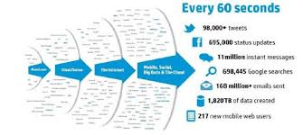
Velocity
Notes:
Velocity
Velocity refers to the speed at which the data is generated, collected and analyzed. Data continuously flows through multiple channels such as computer systems, networks, social media, mobile phones etc.
In today’s data-driven business environment, the pace at which data grows can be best described as ‘torrential’ and ‘unprecedented’. Now, this data should also be captured as close to real-time as possible, making the right data available at the right time.
The speed at which data can be accessed has a direct impact on making timely and accurate business decisions. Even a limited amount of data that is available in real-time yields better business results than a large volume of data that needs a long time to capture and analyze.
Several Big data technologies today allow us to capture and analyze data as it is being generated in real-time.

Slide 5
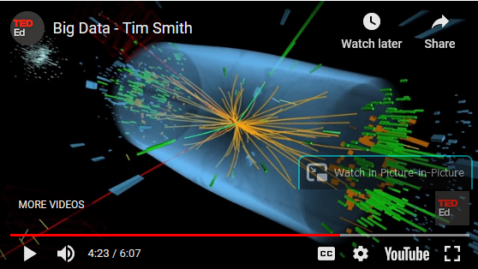
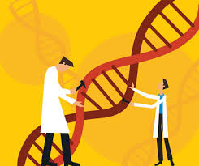
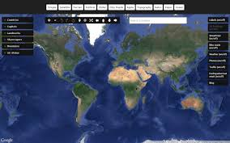

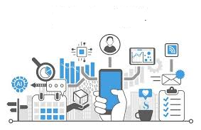
Volume
Notes:
Research Labs like CERN wants to find out the unimaginable small particles of the matter and photon is sent to the particle with millions of sensors, 3D camera that produces really large data.
In the medical research genome sequences, cell populations, proteins, metabolites, RNA, DNA associations and relationship, gene editing also prodcues very high volume of data.
The map of the globe, real-time analysis of the objects of the globe captured from many satellites is also an example of very high volume of data. Traffic management, terroriste attacks, Traffic management, Werther forecasting and manay more are the applications.
Astronome / Space research deals with very powerfull microscopes and send satellite to capture the images of the movement and different events of bilions of stars of the Universe that also produces very high volume of data.
In the Business process also, Organizations collect data from a variety of sources, including business transactions, smart (IoT) devices, industrial equipment, videos, social media and more. Such data is also high in volume. In the past, storing it would have been a problem – but cheaper storage on platforms like data lakes and Hadoop have eased the burden.

Slide 6





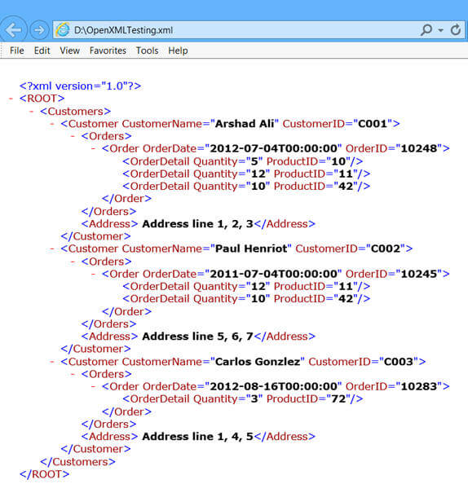
Variety
Notes:
Organizations only automate the frontline business process, however overwhelmed with text files, spreadsheets, presentations, images, graphics, audio files. Video files, animation files. Relational data, html data, xml data, Json data, emails and many others.
Personal workspace of CSE/IT/MCA students are also overwhelmed with class notes with pdf, ppt, snaps from notebook/book, websites, whatsup text, emails, facebook and others.

Slide 7
In SAS, variety comes also in two ways:
Variability:
In addition to the increasing velocities and varieties of data, data flows are unpredictable – changing often and varying greatly. It’s challenging, but businesses need to know when something is trending in social media, and how to manage daily, seasonal and event-triggered peak data loads.
Veracity:
Veracity refers to the quality of data. Because data comes from so many different sources, it’s difficult to link, match, cleanse and transform data across systems. Businesses need to connect and correlate relationships, hierarchies and multiple data linkages. Otherwise, their data can quickly spiral out of control.

Slide 8
Why Bigdata is important?
Large data is a scope to find the root cause,
Build new application while bigdata is high-powered with analytics,
Data-driven decision
Notes:
The importance of big data doesn’t revolve around how much data you have, but what you do with it. You can take data from any source and analyze it to find answers that enable 1) cost reductions, 2) time reductions, 3) new product development and optimized offerings, and 4) smart decision making. When you combine big data with high-powered analytics, you can accomplish business-related tasks such as:
Determining root causes of failures, issues and defects in near-real time.
Generating coupons at the point of sale based on the customer’s buying habits.
Recalculating entire risk portfolios in minutes.
Detecting fraudulent behavior before it affects your organization.
Data-Driven Decision in perspective of Business
Well-managed, trusted data leads to trusted analytics and trusted decisions. To stay competitive, businesses need to seize the full value of big data and operate in a data-driven way – making decisions based on the evidence presented by big data rather than gut instinct. The benefits of being data-driven are clear. Data-driven organizations perform better, are operationally more predictable and are more profitable.

Slide 9

Modern Scenario
Data is captured from various sources including IoT, devices etc,
Uses Deep Learning, Machine Learning, analytics to understands the root cause,
Share through cloud both services and data

Slide 10
Data-driven decision making in Life sciences
Patient-Level Insights Are Driving Competitive Advantage.
We Are Moving Beyond The Data Warehouse To The “Data Lake.”
The Data Scientist Is Becoming A Key Role In Commercial Organizations.
New Technologies Are Rapidly Changing Cost & Capability Dynamics.
Notes:
1. Patient-Level Insights Are Driving Competitive Advantage. Organizations are looking to patient data for real-world drivers of brand use — to explain the drivers behind the trends and better inform commercial activities from brand planning to sales targeting.
2. We Are Moving Beyond The Data Warehouse To The “Data Lake.” Companies are building data hubs to provide comprehensive access to the information necessary to create new insights that data warehouses cannot deliver.
3. The Data Scientist Is Becoming A Key Role In Commercial Organizations. New insights drive decisions when market conditions are changing, and new products are being launched. Data scientists provide the necessary link between business knowledge and analytics expertise to provide these insights.
4. New Technologies Are Rapidly Changing Cost & Capability Dynamics. NoSQL databases, Hadoop, and cloudbased platforms are significantly driving down the cost and time necessary to create value from information initiatives.

Slide 11
Application of Big Data in Life Sceince
Research
Commercial Perspective and Biomedical Research
Clinical Applications
Product Development
Notes:
Product Development
Big data, if used effectively, can help to accelerate product and service development – from genomic sequencing and analysis to the causes of a disease and its progression. The amount of data involved in these spheres can be staggering. The ability to use that data to make decisions about a potential new product can differentiate an organization from its competitors.
New products and services can be developed that are only feasible through the effective management and analysis of big data. These include patient monitoring, through a variety of sensors, to create a complete picture of an individual’s, or a whole population’s health as they react to treatment.
If your R&D scientists need information about a molecule, disease or drug, big data searches can be employed to parse through huge volumes of news, web, text, public or private databases to zero in on the topic of interest and reduce product development times.
Clinical Application
Big data analysis can help accelerate product development during the clinical trials of a new drug. Big data can be used to precisely identify and target the most suitable patients for recruitment to a drug trial. Results from clinical trials can be amassed and analyzed in real time with big data analytics and this can significantly shorten this time-consuming part of the product lifecycle.
Once a drug or medical device is approved and in use among patients, a huge volume of data is available through a variety of sources. This data on the efficacy of a product can be analyzed and used to improve patient adoption or adherence to treatment. It may also provide early indication of any adverse reaction to the medication so that action can be taken to mitigate the impact on patients. Big data analysis can also be used to improve Clinical Supply Management. It can help identify potential product supply issues and even anticipate service issues or device failures.
Commercial Perspectives and Biomedical Research
Big data analytics can help life sciences organizations at any point along the sales cycle from measuring and improving marketing effectiveness to competitive product analysis and customer support.
Unstructured data sources such as social media and customer complaints can be mined, interpreted and reported upon to provide early insight. Patient outcome benefits measurement (ACA, Medicare & PCORB) can be analyzed with big data analytics and this can lead to product quality improvements and ultimately improved sales.
Finally, big data can be used to improve life sciences organizations’ operational efficiency. From production through sales and distribution to customer support, data collection and analysis can identify internal problems or barriers to performance that can be addressed to improve productivity.
In biomedical research and development, data integration independent of the application is not feasible due to the complexity of the data. Therefore, data are wasted in unused silos and a lot of connections in the data are not evaluated and therefore not accessible for further analysis. Suitable big data approaches can transform such data into valuable knowledge resources by integrating the data and make them accessible for further analysis. Furthermore, the data can be evaluated by machine learning algorithms to identify disease mechanisms or appropriate therapy options, for example.
In the following some projects in the area of big data in life sciences are listed:
HUMIT – Human-centered support of incrementally-interactive data integration using the example of high-throughoutput processes in Life Sciences
Big Data Alliance – The Fraunhofer Alliance “Big Data” supports medical professionals with data-driven approaches in the fields of diagnosis and therapy, patient care and research
Optiscell – System platform for marker-free identification and manipulation of solitary cells in biomanufactoring engineering
GoSmart – Generic open-end simulation environment for minimally invasive cancer treatment
Research
Research in various fields of Gene, Disease, source of life, findings of life and etc.

Slide 12
What is Cloudera?
Cloudera Data Platform is the industry's first enterprise data cloud:
Multi-function analytics on a unified platform that eliminate silos and speed the discovery of data-driven insights
A shared data experience that applies consistent security, governance, and metadata
True hybrid capability with support for public cloud, multi-cloud, and on-premises deployments
We empower people to transform complex data, anywhere it resides, into clear and actionable insights
Cloudera is leading hospitals to better cancer cures, securing financial institutions against fraud and cyber-crime, and helping humans arrive on Mars — and beyond.
But even the most transformative organizations had to start somewhere. That's where we thrive:
Guiding passion into proofs of concept
Extracting value from vision.
Empower continuous optimization and learning across the enterprise
Turning data into predictions at any scale, anywhere
Notes:
From autonomous vehicles and surgical robots to churn prevention and fraud detection, enterprises rely on data to uncover new insights and power world-changing solutions.
It all starts with a data platform that enables you to say "yes". Yes to the analytics your people want to use. Yes to operating on any cloud your business requires. Yes to the future with a cloud-native platform that flexes to meets your needs today and tomorrow. And we have delivered. Cloudera Data Platform is the industry's first enterprise data cloud:
Multi-function analytics on a unified platform that eliminate silos and speed the discovery of data-driven insights
A shared data experience that applies consistent security, governance, and metadata
True hybrid capability with support for public cloud, multi-cloud, and on-premises deployments
We empower people to transform complex data, anywhere it resides, into clear and actionable insights
Cloudera is leading hospitals to better cancer cures, securing financial institutions against fraud and cyber-crime, and helping humans arrive on Mars — and beyond.
But even the most transformative organizations had to start somewhere. That's where we thrive:
Guiding passion into proofs of concept
Extracting value from vision.
Empower continuous optimization and learning across the enterprise
Turning data into predictions at any scale, anywhere

Slide 13


Thank you
Any suggestion, alternation, addition is welcome to enhance the understanding and extending the knowledge on this topic.

